Slide 1
Basic Preemptive OS
Components

Slide 2
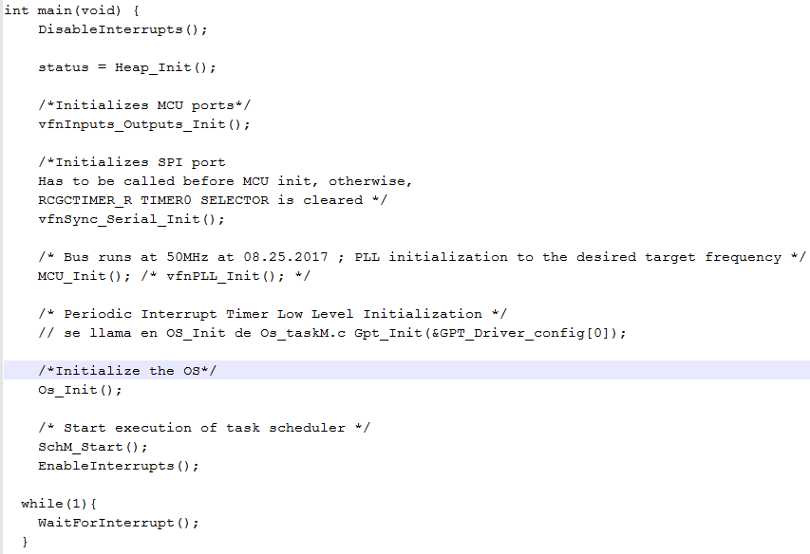
Main ()

Slide 3
Task state
A task typically can be in any one of the three following states:
1. Running
2. Ready
3. Suspended
In this single-processing system there can be only one task running. A task can enter the running state from the ready state; If it is eligible to run based on its priority or its position in the scheduler list.

Slide 4
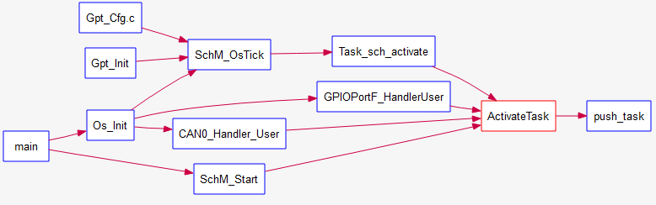
Activate Task(TaskType taskID)
This API receives as input the taskID parameter and switches its state from SUSPENDED to READY, if no error occurred, it pushes this task into the priority buffer according to task priority. There are two types of tasks, periodic task and triggered task, the firs type takes one additional step to be activated (turned to READY state), it calls to Task_sch_activate(), whereas the second type just calls ActivateTask(TaskType taskID).

Slide 5
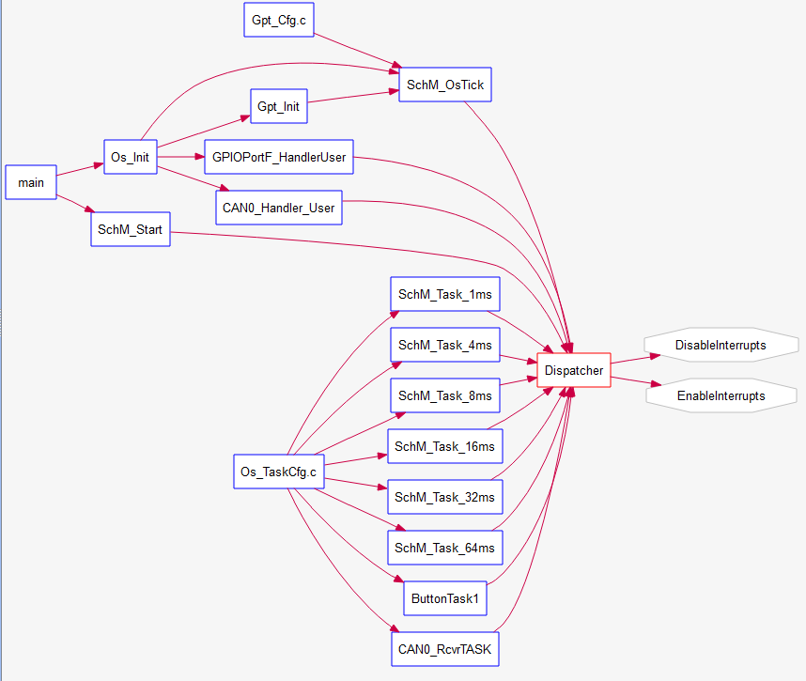
Dispatcher
The dispatcher searches on the priority buffer FIFO and picks up the next task to be executed.
It finds the higher priority and oldest task in READY state to switch its status to RUNNING and
returns the pointer to the task to be executed, but doesn’t execute it, that’s the function of
restore_context() explained later in this document.
Dispatching a task implies it’s previous Activation. Basically ActivateTask(TASKID) is cyclically
running in SchM_OsTick meaning it shall be possible to interrupt the current task to
allocate in the execution buffer the next entry.

Slide 6
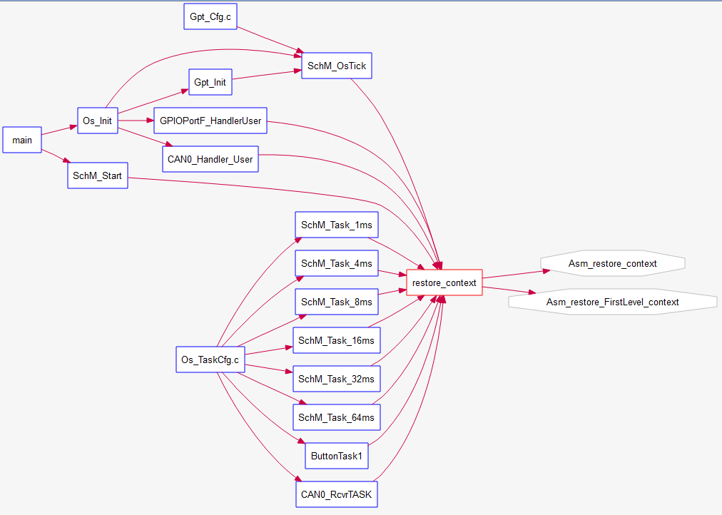
Restore Context
Dispatcher selects who’s next in RUNNING, but restore_context() shifts the stack and POPS data to run the task.

Slide 7
Calls from tasks
In OSEK, a task can only terminate itself, each tasks shall terminate itself at the end of its code. Then, three functions must be called at the end of overall tasks, these functions are described below.
1. statusOS = TerminateTask() ;
2. Dispatcher();
3. restore_context();
Tasks Termination
Both types of tasks terminate themself by calling TerminateTask(). This function terminates the task transferring it from RUNNING to SUSPENDED state and the operating system makes the results of the task available to other tasks and informs whether the function terminated normally “E_OK” or wrongly mean “E_OS_LIMIT. Both results will be saved in the result variable statusOS (statusOS = TerminateTask()).

Slide 8
File dependencies
6
1
Config. header
Main header
<driver>_Cfg.h
<driver>.h
Contains the public declarations, definitions and prototypes to be exported from the driver.
Contains the driver core functionality (internal).
Contains the private declarations, definitions and prototypes (used internally by the driver)
Contains driver internal type declarations.
Contains standard types used by the project
Project configuration header file
Project configuration code (usually constants)
7
Config. code
<driver>_Cfg.c
4
2
3
Driver types
Main code
Prototypes
<driver>_Types.h
<driver>.c
<driver>_Private.h
5
Standard types
Std_Types.h
Driver file
A
B
A includes B
Project configuration file

